Slide 1
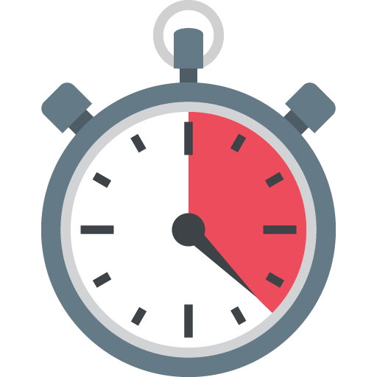
Creating a Stopwatch app
with qt designer
John mel bolaybolay
Dennis ivan baliguat

Slide 2
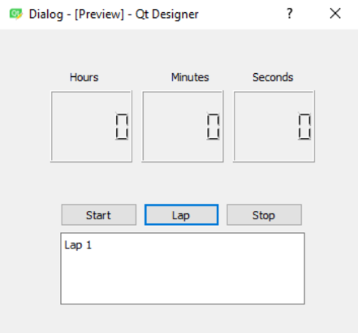
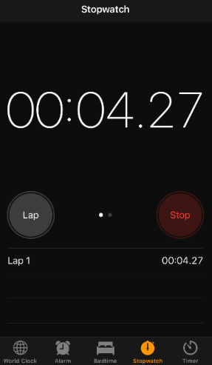
checklist
Should look like..
Should work like..
Should display laps taken

Slide 3

Our bucket list
Display the difference between laps
Be able to save the recorded laps to a .txt file
Running it as an executable file

Slide 4
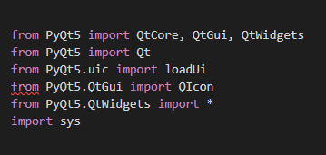
Packages used

Slide 5
class Ui_Mainwindow
Unified
Modeling
Language
def setupUi
def retranslateUi
def display
def tick
def do_start
def do_reset
def do_pause
def save_file
def InsertData

Slide 6
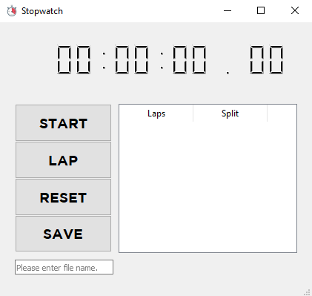

The application

Slide 7

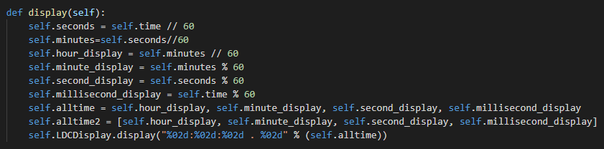


Slide 8
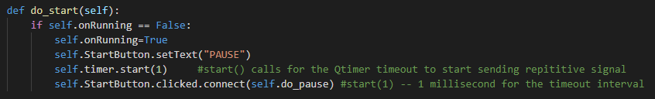

Slide 9
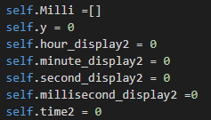
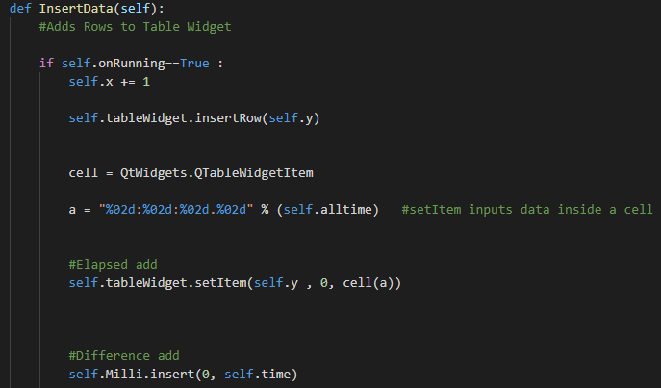
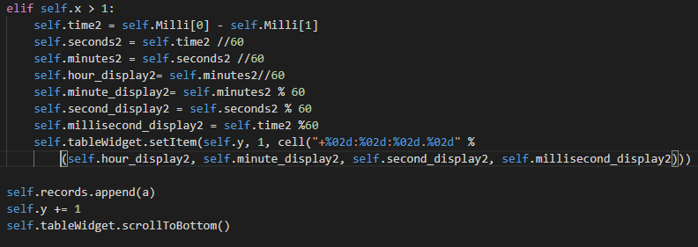

Slide 10
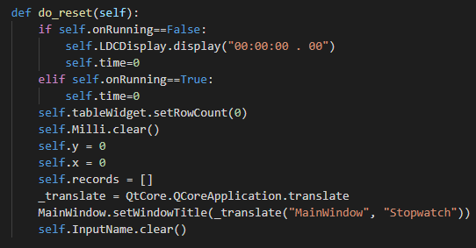

Slide 11
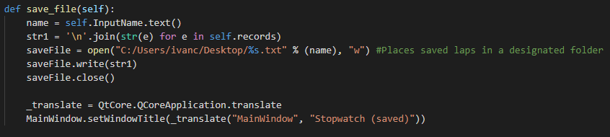

Slide 12
demo

Slide 13
THANKS FOR LISTENING!

